Slide 1
University of New Haven
Vehicle Detection using Convolutional Neural Network(CNN)
CSCI-6401-01
Professor : Dr. Shivanjali Khare

Slide 2
Introduction
The advancement of technology and occurrence of such techniques developed problems for the people and on the other hand provide efficient solutions to some problems. In recent times deep learning have received a lot of attention they have the quality to perform feature detection. Using these techniques, computers may understand what each piece of data means and what each model it corresponds to actually represents.
Our project mainly is to implement the algorithms techniques Convolutional Neural Network (CNN) used to identify different object especially the focus is on detecting variations of vehicles.

Slide 3
Research Question
Vehicle detection covers the area of security and artificial intelligence which makes it more interesting when working with large image set. Python and machine learning algorithm made it easy for the scientist and programmers to easily identify the object of any kind of type with the usage of ml models.
The research question of this project is that the detection of vehicles and non -vehicles from the normal traffic and to identify the behavior of the algorithm.

Slide 4
Motivation behind the choice
Machine learning algorithms and AI provides benefits to the organization and different companies working on a large scale. There is a big gap between the technology and daily matters of life like cars are going in a queue from a motorway or highway .
The traffic security might be searching for any specific car involved in any crime these sort or researches and automated work can provide benefit . The reason for choosing such topic is to spread the applications of deep learning among the common people irrespective of their educational background.

Slide 5
Literature Review
The researchers have used deep learning CNN model detection to perform feature detection. Model training has been done on the vehicle dataset using faster R-CNN and R-CNN, by putting the trained vehicle detector to the test on the testing data, it also seeks best results for vehicle detection.
Additionally, the results from these methodologies are contrasted with those from experimental analysis. With the model conclusion it has been observed that the faster r-cnn tends to perform better than the other discussed model.
The limitations of such approaches often make these models slow as the dataset as it is not based on numerical or strings datatypes but of images and videos which often slow down the speed of such models.

Slide 6

Methodology
Dataset description: The image collections dataset which was divided into two categories one is of non vehicle and other for vehicle. All the traffic which includes different kinds of cars and other vehicle contains car in them while non vehicle data contains some blur images and empty roads. The Datasets which used in this project are COCO datasets.
Model Training: The initials before fitting the parameters dataset was divided into the ratio of 70/30 for train-test split. Both the vehicle and non vehicle are separately splitted. Target image for the model was 250 and using the tensor flow libraries further parameters are set.

Slide 7
Methodology
Model selection: Convolutional neural network (cnn) has been chosen and fitted with several parameters like relu which is an activating parameter, it returns 0 if it is negative and returns random value if it is positive.
The deep layers which is connected to its preceding one with neurons have been activated using the sigmoid function which shows the non-linear relationships.
Early stopping parameter has been used to avoid the over fitting of the variables and to improve the fitting with each iteration.

Slide 8
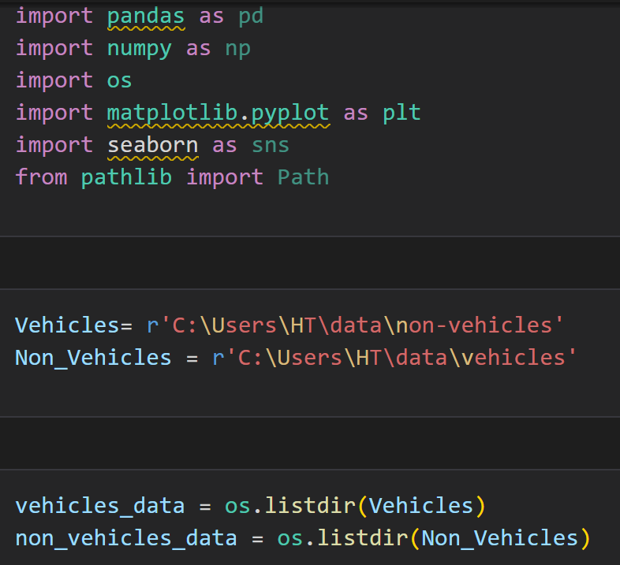
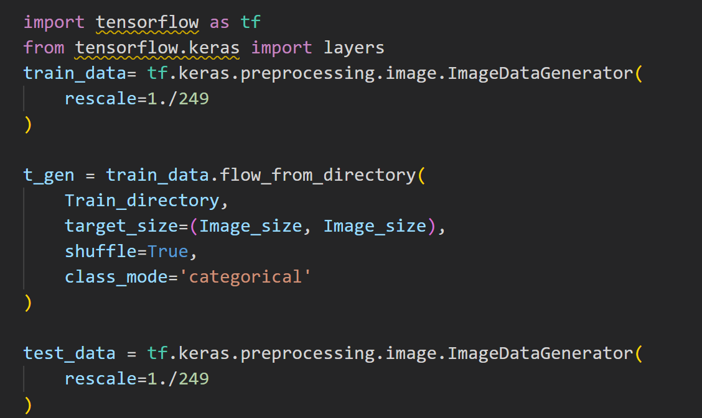
Code
Importing dependencies
Finding images in the directories

Slide 9
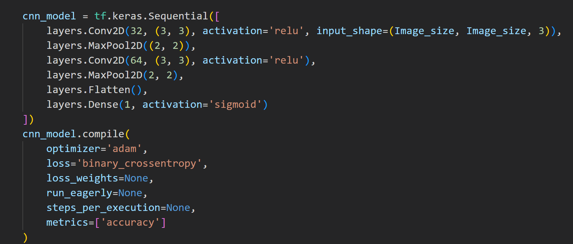
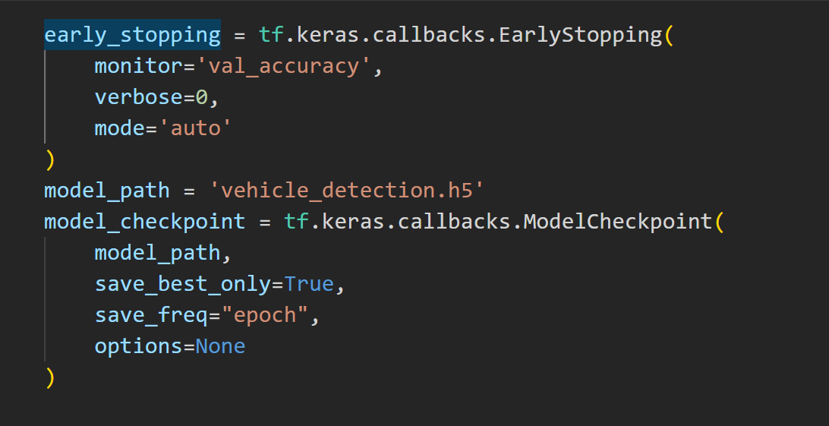
Convolutional Neural Network CNN
Training the model

Slide 10
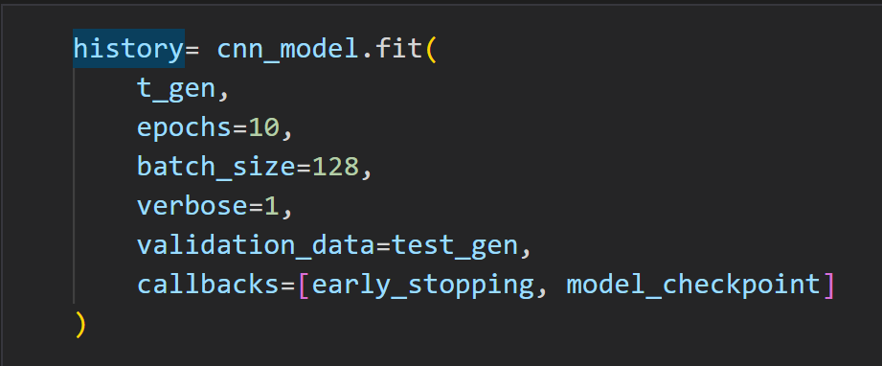
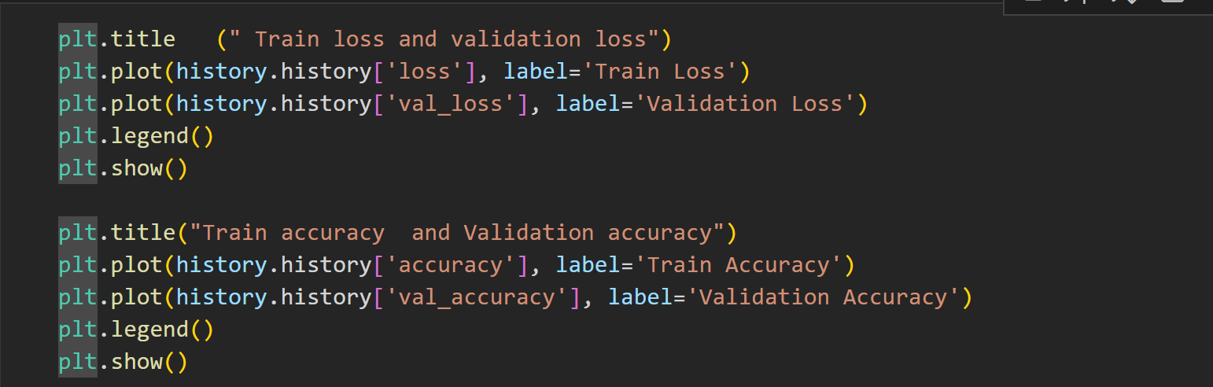
Training model

Slide 11
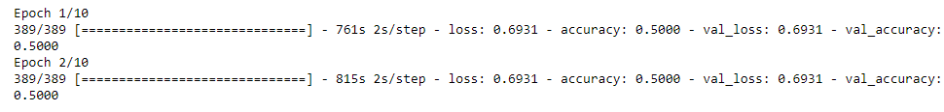
Results
The Epoch calculation showed the loss and accuracy of the model which shows that the model accuracy and score was 50%.

Slide 12
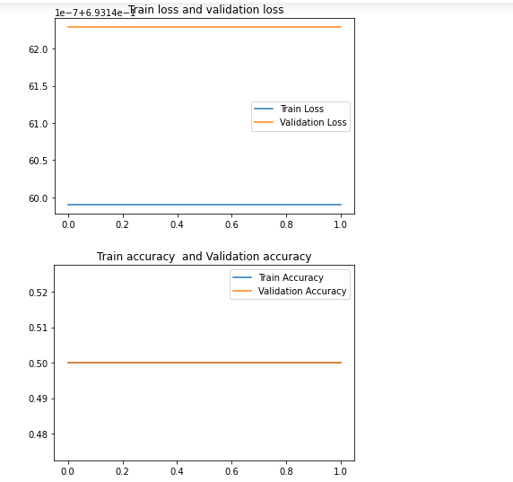
Output

Slide 13
Conclusion
The proposed method has been evaluated using the deep learning algorithm cnn . Model was to train on trained data with 70 percent of ratio from the total data. Accuracy of the model was not good so far as per the image set which was only 50% . The main aim of the research was to detect the vehicle presence by processing the algorithms through the image dataset which have been found by the cnn algorithm.

Slide 14
Limitations
When working on the deep learning or even machine learning algorithms after gathering the data from various sources and optimizing the model with several parameters there are always something left behind either in the data collection process. Pre-processing task or in the fitting of the mode. This research based implementation lacks the quality of data analyzing images collection is such a task which really needs attention. A proper csv file or some file with images annotation which can be easily analyzed when in the numerical format .

Slide 15
Future Recommendation
Based on this research task where cnn have been used to detect the vehicle . Work can be improved in the future with video data and using the opencv modules can make it more better with the measures from different angles. Opencv module can detect the cars from a long distance which can provide better and efficient automation for security purposes.

Slide 16
THANK YOU

